Slide 1
Lesson 1.1 Using Eclipse and Practice-It
Objectives
Describe one or more careers related to computer science and technology.
Write sequential instructions to solve a problem.
Ask intelligent questions about the field of computer science.
Identify 'next steps' to learn more about computer science
Assessments
Demonstrate Plug-In and Un-Plug procedures
Log in and submit a sample problem in Practice-It
Homework
Visit pokemon.com and play a few games or play Pokémon on a gaming system
Visit bulbapedia.bulbagarden.net to familiarize yourself with the Pokémon franchise

Slide 2
Lesson 1.2 Algorithms and Computational Thinking
Objectives
Define algorithms, programs, hardware, software, and operating systems.
Describe the relationships between these concepts and components.
Assessments
Write sample algorithms
Assemble and debug a program that directs the instructor to make a sandwich
Homework
Read HW 1.2 and complete worksheet

Slide 3
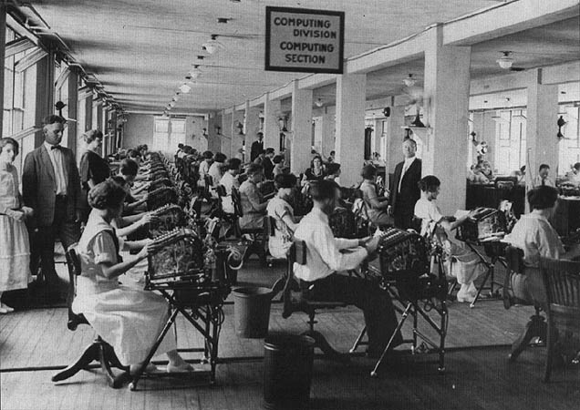
Notes:
Lesson 1.2
- “early computers were mostly women”

Slide 4
Lesson 1.3 String and Console Output
Objectives
Correctly assemble a complete program with a class header, body, and main method.
Correctly use print, println, and escape sequences.
Assessments
Create starter Pokémon program
Complete several Practice-It questions
Homework
Read HW 1.3
Complete Ch.1 exercises 1-5

Slide 5
Lesson 1.4 Common Errors and Comments
Objectives
Create simple programs with comments.
List and apply the steps necessary for avoiding syntax errors.
Assessments
Complete a worksheet
Develop a personal checklist for spotting syntax errors
Homework
Read HW 1.4
Complete Ch.1 Exercises 6, 7, 9

Slide 6
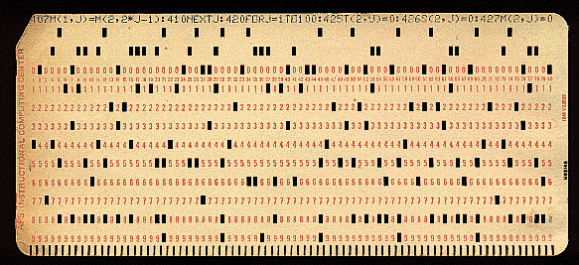
Notes:
Lesson 1.4
- Punch card

Slide 7

Notes:
Lesson 1.4
- A computer with a stack of punch cards

Slide 8

Notes:
Lesson 1.4
- Jaquard loom, the first mechanical device to use punch cards

Slide 9
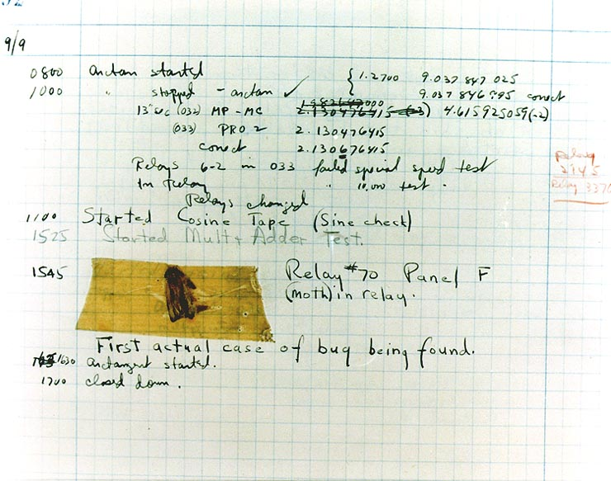
Notes:
Lesson 1.4
- A page from the Harvard Mark II electromechanical computer’s log, featuring a dead moth that was removed from the device

Slide 10
Lesson 1.5 Static Methods and Method Calls
Objectives
Use procedural decomposition to plan complex programs using structure diagrams.
Manage complexity by using method calls
Assessments
Complete Practice-It problems
Homework
Read HW 1.5
Complete Ch.1 Exercises 11, 12, 14, 16

Slide 11
Lesson 1.6 Static Methods and Method Calls
Objectives
Use structure diagrams to plan complex programs.
Manage complexity by using method calls
Assessments
Complete Practice-It problems
Write a structured Pikachu program
Homework
Outline Ch.1
Complete Programming Project #1* & #3 (must include a structure diagram for each)

Slide 12
Programming Challenge!
Write a Java program called StarFigures that generates the following output.
You MUST include a structure diagram or your answer will be disqualified.
A correct answer will use static methods to show structure and eliminate redundancy in your solution.
Notes:
Lesson 1.6
Programming Challenge

Slide 13
*****
*****
* *
*
* *
*****
*****
* *
*
* *
*****
*****
*
*
*
*****
*****
* *
*
* *
Notes:
Lesson 1.6
Programming Challenge II (target output)

Slide 14
Lesson 1.7 Programming Project
Objectives
Construct a program containing method calls and static methods.
Assessments
Submit a complete, functional program by the end of class.
Homework
Check class notes for completion, adding daily summaries if needed.

Slide 15
Lesson 1.8 Finding and Fixing Errors
Objectives
Find errors in returned homework assignments.
Correct code
Assessments
Re-submit all homework assignments with corrected answers.
Homework
Study for the test by:
Reviewing all the blue pages at the end of Chapter 1
Re-reading sections as needed
Submit 5 questions for review in class tomorrow using electronic survey

Slide 16
Lesson 1.9 Review
Objectives
Identify weaknesses in Unit 1 knowledge.
Assessments
Create a personalized list of review topics to guide tonight’s study session.
Homework
Study for tomorrow’s test!

